Slide 1
“Halos and Galaxies in Cosmological Hydrodynamical Simulations”
20110170 Shin-Jeong Kim
21110106 Jun Kwon
21110111 Sung-Hwa Hong
2021- 1 Advanced Astrophysics class project

Slide 2


Tasks completeness : 50 % - Rockstar : Success
- Velociraptor : Fail
Shin-Jeong Kim
Sung-Hwa Hong
Jun Kwon

Slide 3
CONTENTS OF OUR PRESENTATION
INTRODUCTION
SIMULATION SNAPSHOT
FINDING HALOS WITH ROCKSTAR
CONCLUSION & SUMMARY

Slide 4
1. INTRODUCTION
Gadget snapshot & visualisation plot
Find halo and compute all the statistics & shapes

Slide 5
ABOUT DARK MATTER HALOS
1. INTRODUCTION
Dark Matter
The first virialized object in the Universe
Building blocks of structure formation
Key component of cosmic web
Make up 27% of the universe
Not visible, but only detectable through gravitational effects
Key role in understanding the galaxy formation and evolution
5%
BARYON
68 %
27 %
DARK ENERGY
DARK MATTER

Slide 6
2. SIMULATION SNAPSHOT

Slide 7
2. SIMULATION SNAPSHOT - PARAMETERS AND VALUES
 | VALUES | VALUES
REDSHIFT | 2 | 3
BOX SIZE | 25 Mpc / h | 25 Mpc / h
HUBBLE PARAMETER h | 0.678 | 0.678
Omega M | 0.308 | 0.308
Omega Lambda | 0.768 | 0.768
N GAS | 7709894 | 8161167
N DM | 8998912 | 8998912
N STAR | 1289018 | 837745
FLAG SFR | 1 | 1
FLAG FEEDBACK | 1 | 1
GADGET-3 SNAPSHOT
GADGET is free software for cosmological N-body/SPH(smoothed-particle hydrodynamics) simulations.
The primary result of a simulation with GADGET are snapshots, which are simply dumps of the state of the system at certain times.

Slide 8
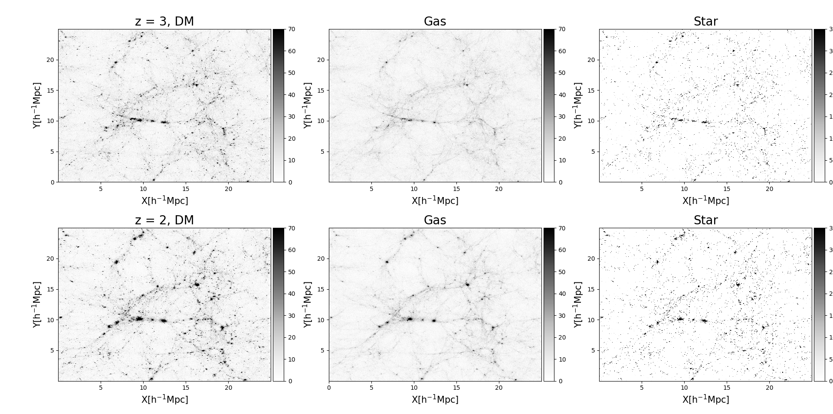
2. SIMULATION SNAPSHOT - PARAMETERS AND VALUES

Slide 9
PROJECT OBJECTIVES
WHAT IS THE FUNDAMENTAL PROPERTIES OF DM ?
HALO STATISTICS
HALO SHAPE

Slide 10
3. FINDING HALOS WITH ROCKSTAR

Slide 11
ROCKSTAR METHODOLOGY
3. FINDING HALOS WITH ROCKSTAR
FOF algorithm
EFFICIENT PARALLEL
WITH LINKING LENGTH
UP TO 10^5 CPUs
7 DIMENSIONS
THEORETICAL RESULT
POSITION, VELOCITY
TIME
=> ACCURACY, PRECISION UP
GIVE ADDITIONAL OUTPUT

Slide 12
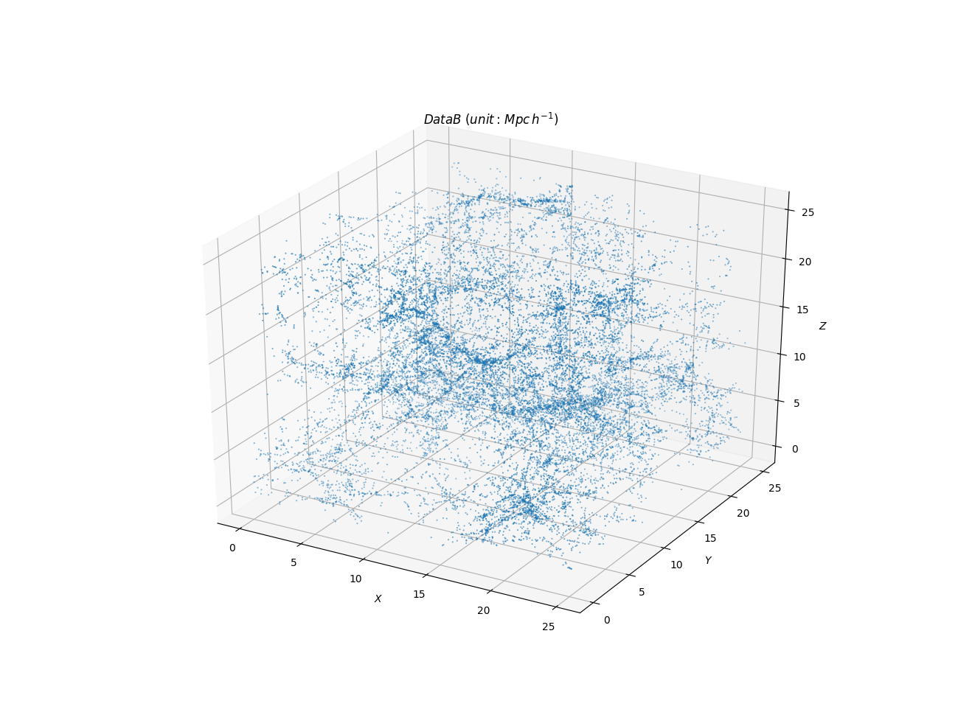

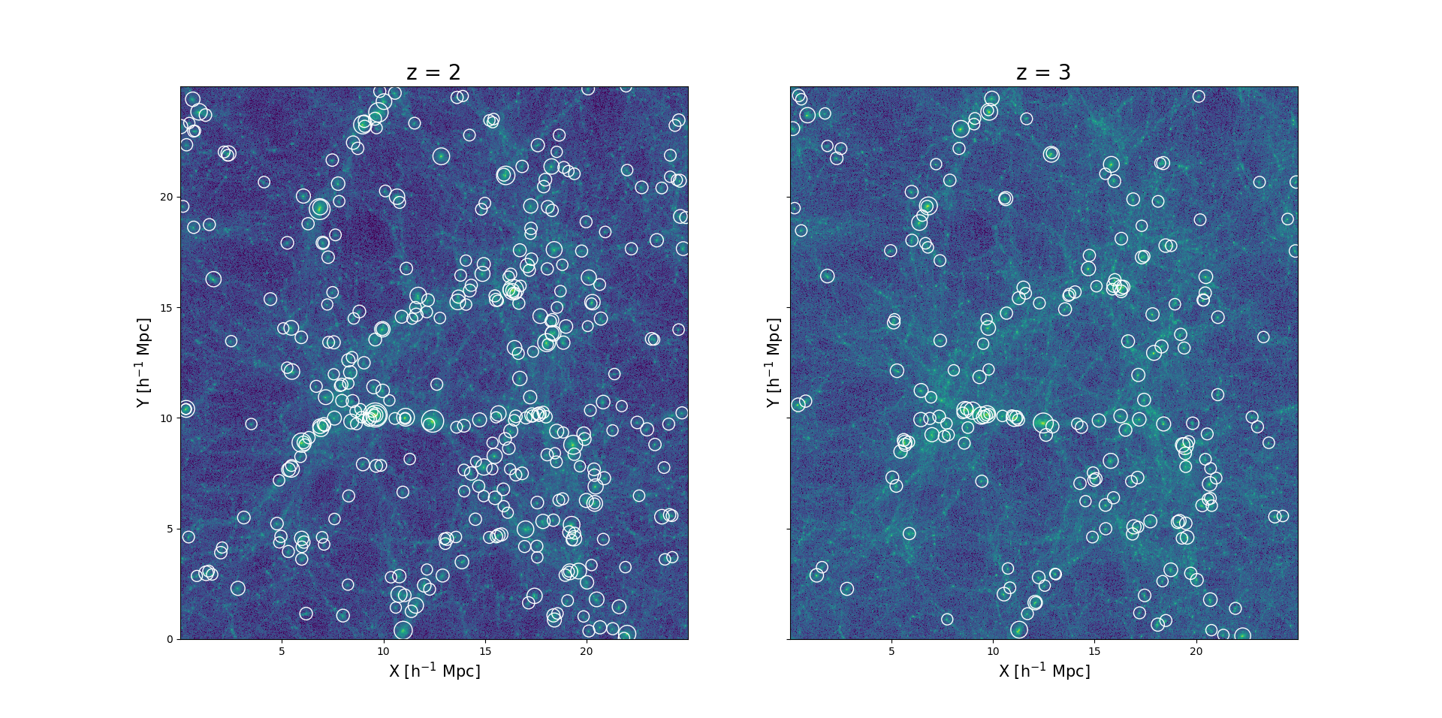
3. FINDING HALOS WITH ROCKSTAR
HALO DISTRIBUTION IDENTIFIED WITH ROCKSTAR AT Z = 2 (LEFT) AND Z = 3 (RIGHT)

Slide 13
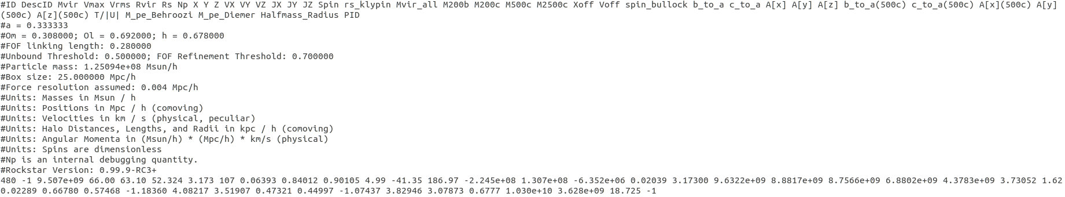
3. FINDING HALOS WITH ROCKSTAR
By default, the output files for Rockstar do not include information about which halos are hosts
To compile, run "make parents" from the Rockstar source directory.
2. /path/to/rockstar/util/find_parents <box_size> out_XYZ.list
OUTPUT

Slide 14

HALO STATISTICS
3. FINDING HALOS WITH ROCKSTAR

Slide 15
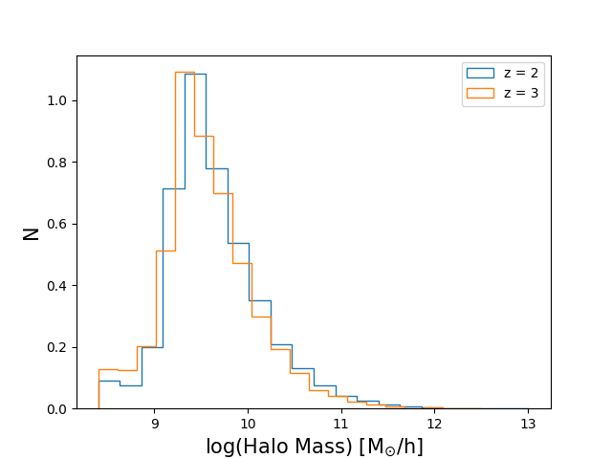
3. FINDING HALOS WITH ROCKSTAR / HALO STATISTICS
Normalized number of halo mass at z = 2 (orange) and 3 (blue).
 | z = 2 | z = 3
Mean | 9.64 | 9.58
Median | 9.56 | 9.51
std | 0.52 | 0.50
Notes:
This shows the histogram of halo mass identified with rockstar. The blue and orange color represent the z = 2, and 3. The mean, median halo mass is a little bit higher at redshift 2 than redshift 3.

Slide 16
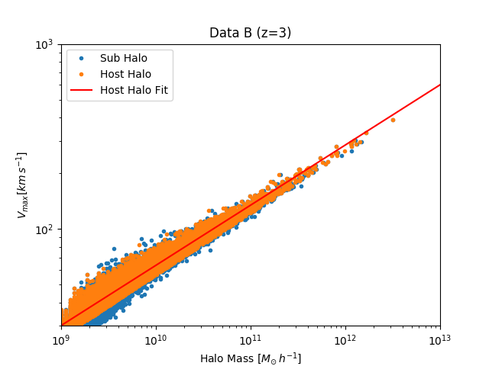
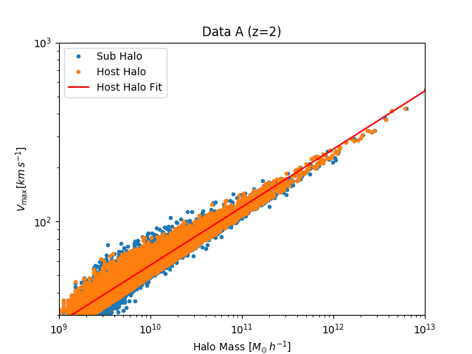
3. FINDING HALOS WITH ROCKSTAR / HALO STATISTICS
MAX CIRCULAR VEL. - Mvir RELATION
The relation for sub-halo has slightly more scatter and is slightly biased towards lower masses at fixed Vmax, a consequence of dynamical stripping.

Slide 17
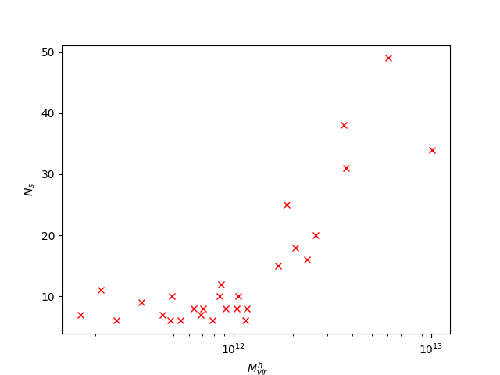
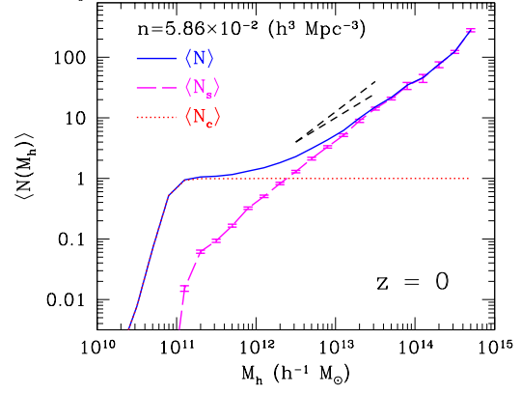
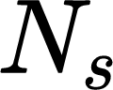
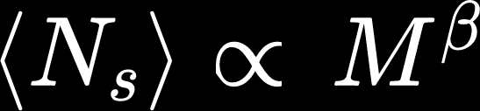
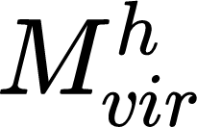
3. FINDING HALOS WITH ROCKSTAR / HALO STATISTICS
NUM OF SUBHALOS - HOST Mvir RELATION
, Kravtsov (2004)
Notes:
오빠 저 논문에서 플랏 가져올때, 저자이름 표기해야해여! 예를 들면 Kim et al. (2021) 이런식으로 ㅋㅋ

Slide 18
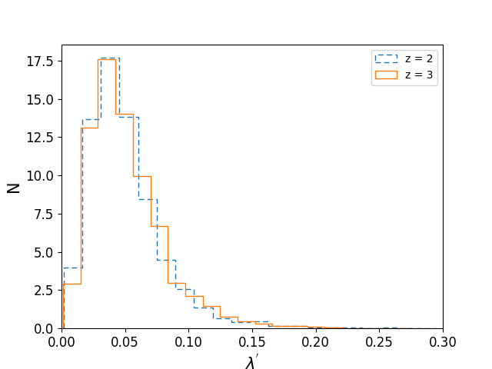
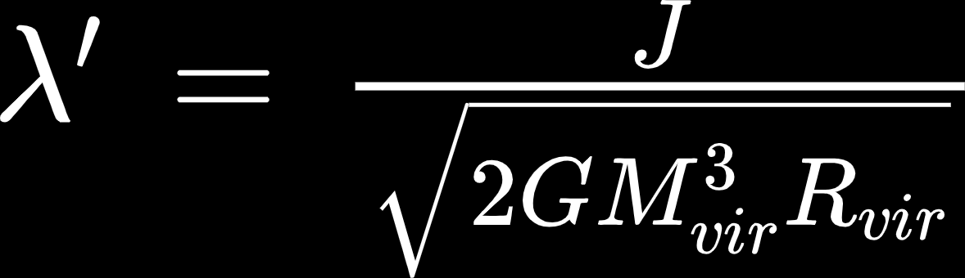
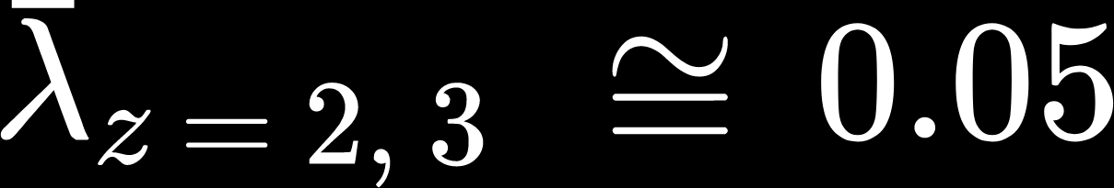
3. FINDING HALOS WITH ROCKSTAR / HALO STATISTICS
Histogram of SPIN PARAMETER of halos
Quantified angular momentum of a halo
, bullock
Halos are not supported by the rotation but by the random motions.
Notes:
Here, we present the spin parameter lambda of halos. Spin parameter lambda prime which is quantified angular momentum of a halo. The spin parameter is expressed by this, which indicates the amount of the rotation. So, the non-rotating system has a 0 value.
The left plot shows the pdf of lambda prime at z = 2, 3, and as you can see, the mean value of lambda is very small ~ 0.05. This result indicates that halos are not supported by the rotation but by the random motions of its system.

Slide 19
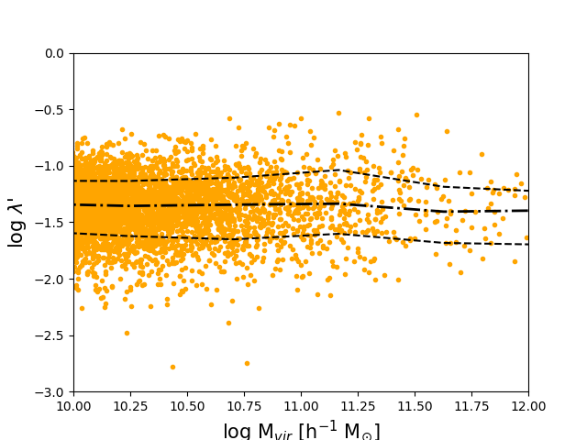
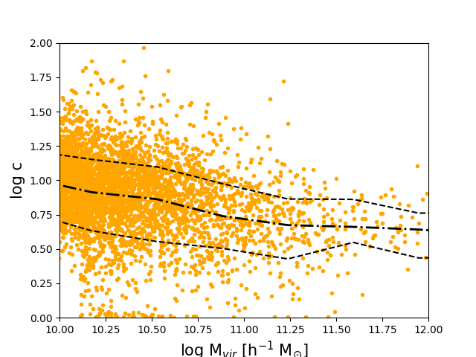
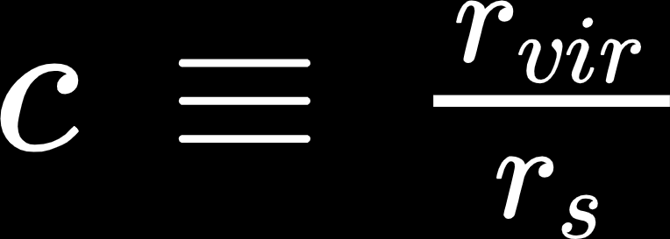
3. FINDING HALOS WITH ROCKSTAR / HALO STATISTICS
SPIN PARAMETER - Mvir RELATION CONCENTRATION - Mvir RELATION
These trend is consistent with Andrea V.maccio et al (2007)
Even with the large scatter,
The spin parameter is independent of Mvir.
Concentration (rvir/rs) is decreasing with the increasing halo mass. -> this can be explained by the merging history of the halos.
Notes:
This shows the spin parameter as a function of halo mass and concentration as a function of halo mass.
Here we define the concentration parameter c as virial radius divided by rs.
The dot-dashed line of the plots indicates the median value, two dashed lines 16, 84 percentile. As you can see, even though, they have large scatter, the spin parameter is independent of the host halo mass.
And concentration is decreasing with the increasing halo mass. This can be explained by the merging history of the halos. When the halos assemble, the density of the outer part of the halos increases, then resulting in decreasing concentration, temporarily.
(If we only select the relaxed halos, we might reduce the large scatter in these plots.

Slide 20
HALO SHAPES
3. FINDING HALOS WITH ROCKSTAR
WHAT IS THE SHAPE OF HALOS ?
SPHERICAL OR ELLIPTICAL?
Notes:
And now, we are gonna talk about the halo shapes. Someone might ask what is the shape of halos, are they spherical or elliptical?

Slide 21
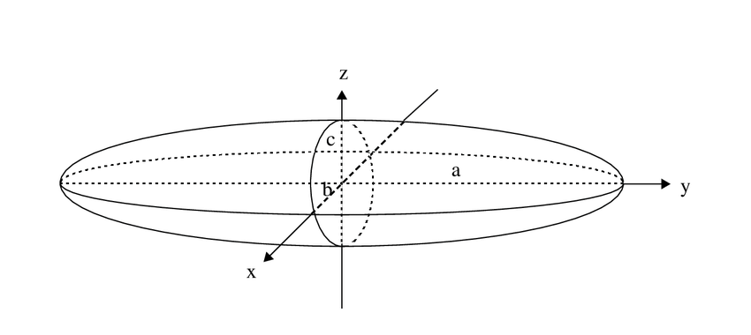
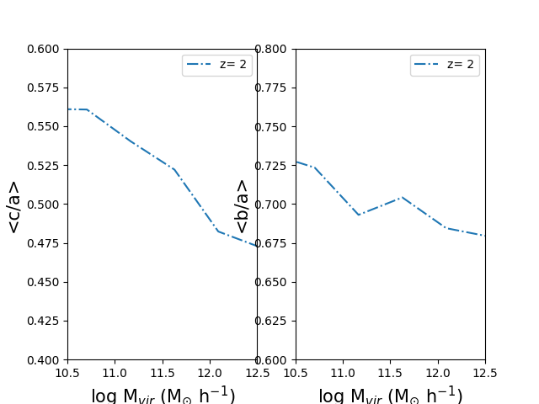
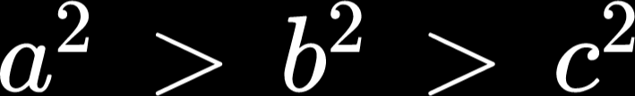
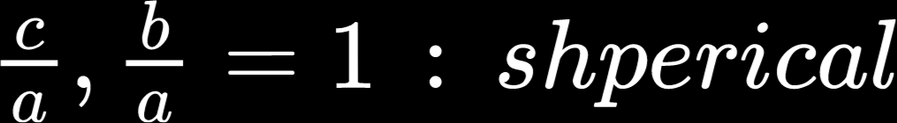
3. FINDING HALOS WITH ROCKSTAR / HALO SHAPES
The mean axial ratio as a function of halo mass
@Jack W Judy (1994)
Halos are often fitted with ellipsoid, ( )
The mean axial ratio c/a and b/a are decreasing with the increasing halo mass.
The less massive halos are more likely to be spherical than the bigger ones.
This can be explained by the merger events that occurred in massive halos, where the mass accretion is often directional leading to an aspherical shape.
Notes:
Actually, halos are often fitted with ellipticals, So, there are 3 axes a,b, and c. A is the longest, b is intermediate, c is the minor axis.
Axial ratio c/a and b/a is often used to describe halo shapes. If c/a and b/a are 1, it is spherical.
We look at the mean axial ratio as a function of halo mass.
As you can see, the mean axial ratio c/a and b/a are decreasing with the increasing halo mass.
This means that the less massive halos are more likely to be spherical than the bigger ones.
This can be explained by the merger events occurred in massive halos, where the mass accretion is often directional. So, it makes the shape aspherical.

Slide 22
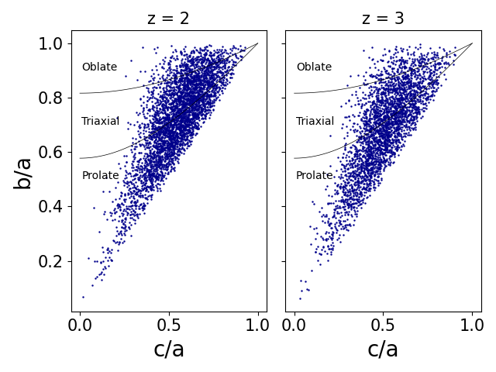
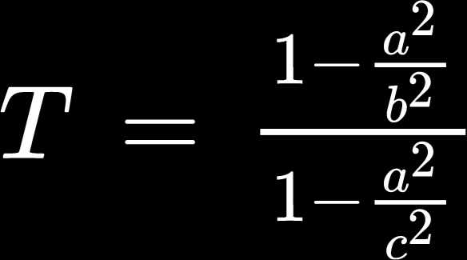
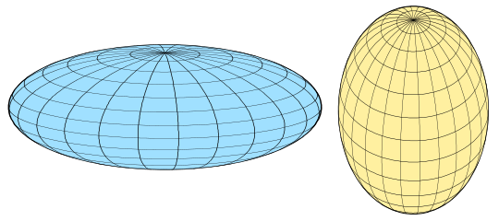
3. FINDING HALOS WITH ROCKSTAR / HALO SHAPES
Triaxiality
@ wikipedia
T = 0 : Oblate
T = 1 : Prolate
The fraction of triaxial and prolate shape is higher than oblate ones.
Notes:
Also, one way to describe the halo shapes is Triaxiality T. T is expressed this way, with the a/b and a/c terms.
If the T is 0, it is purely oblate, and if T is 1, it is purely prolate shape.
This plot shows the relation between the b/a axis ratio and the c/a ratio for z = 2, z =3. The blue points indicate the halos larger than 10^10 solar mass.
The grey thick line separates the oblate, triaxial, and prolate shape region according to their T value.
As can be seen, the fraction of prolate and triaxial is much higher than the oblate shape.
Briefly speaking, most halos are prolate or triaxial rather than oblate shape.

Slide 23
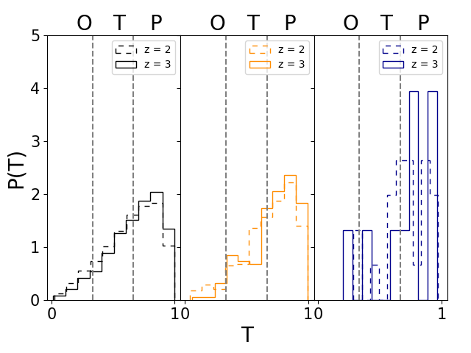
3. FINDING HALOS WITH ROCKSTAR / HALO SHAPES
Dependence of Triaxiality on halo mass and redshift
10 < log M < 11
11 < log M < 12
12 < log M
0 < T < ⅓ : Oblate (pan cake)
⅓ < T < ⅔ : Triaxial
⅔ < T < 1 : Prolate (sausage)
The fraction of prolate is higher in more massive halos. => might be due to merging
At high z (z=3), halos of a given mass are more prolate.
Notes:
And now, we investigate the dependence of T on halo mass and redshift.
The left plot shows the pdf of T.
The color shows the different mass regimes. Black shows the log mass between 10 and 11, orange shows the log mass between 11 and 12, and blue shows the log mass larger than 12. From left to the right, mass is increasing.
On each panel, the solid indicates the z 3, and the dashed line indicates the z = 2.
The T value is from 0 to 1, and each section divided with the grey line shows the oblate, triaxial and prolate shape.
As you can see, most halos at a given mass are prolate with only a few oblates.
Also, the fraction of prolate is higher in most massive halos shown with blue color. This can be related to the merging events. As I said earlier, mass accretion is directional, so it can make halos prolate shape.
Also, I want to talk about the relation between halo shape and redshift.
As I said earlier, the solid line shows the redshift 3 and the dashed line shows the redshift 2.
At redshift 3 at each panel, the probability of prolate is higher than that at redshift 2.
So, we can say, at high z, halos are more prolate. This can be interpreted as halo shape can change with time.

Slide 24
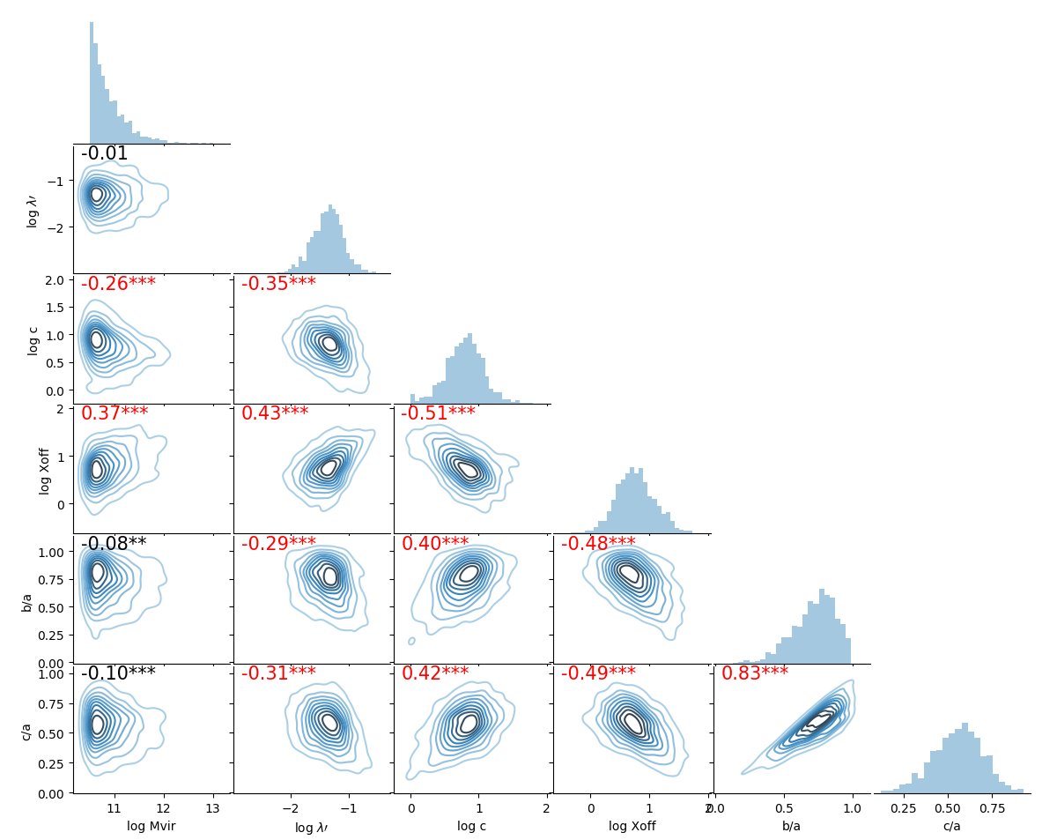
3. FINDING HALOS WITH ROCKSTAR / HALO SHAPES
Xoff : relaxedness of halo
Xoff = 0 : relax
Correlations between halo parameters at z = 2.
Correlation coefficient r value : left top of the each plot
Highlight the r-value ( |r| > 0.3 ) with red color.
Xoff has a positive correlation with
halo mass and spin parameter.
a negative correlation with concentration, and axial ratio (b/a, c/a)
=> Recently merging occurs, the halo mass increases, spin parameter increases, so it is unrelaxed, the concentration decreases, and the halo shapes become aspherical.
Notes:
Finally, this plot shows the correlations between halo parameters at z = 2.
The correlation coefficient r value is shown on the left top of each plot. If the absolute r value is larger than 0.3, we highlight them with red color. Here, we correlate the parameters of halo mass, spin parameter, halo shape, and Xoff each other.
Xoff parameter shows the relaxedness of the halo. If the Xoff is 0, the halo system is relaxed.
In this plot, the Xoff has a positive correlation with halo mass, spin parameter, and Xoff has a negative correlation with concentration and axial ratio. Overall speaking, it can be understood that recent merging occurs and the Halo mass increases, the angular momentum increases, and the spin parameter increases, so it is unrelaxed, the concentration decreases, and the halo shape becomes aspherical.
(종합적으로 이해하자면, 최근에 merging 이 일어나 Halo mass가 커지면서, 각운동량이 증가해서 스핀파라미터가 증가하고, 그래서 unrelaxed 된 상태이며, concentration 은 작아지고, halo 모양이 aspherical 해진다라고 이해할 수 있다.)

Slide 25
CONCLUSIONS
6. CONCLUSIONS
We investigated the fundamental properties of DM identified with ROCKSTAR.
On average, a massive host halo has more subhalos.
The mean value of the spin parameter of halos is 0.05, which indicates that DM are not supported by the rotation.
Massive halos that recently underwent mass accretion are less concentrated, unrelaxed, and more likely to be prolate,
At high z (z=3), halos at a fixed mass are more prolate.
Halo shape can change by merging process and with time
Notes:
Let me conclude our presentation.

Slide 26
THANKS!
Do you have any questions?
TEAM 2
SHIN-JEONG KIM
JUN KWON
SUNG-HWA HONG

